Slide 1
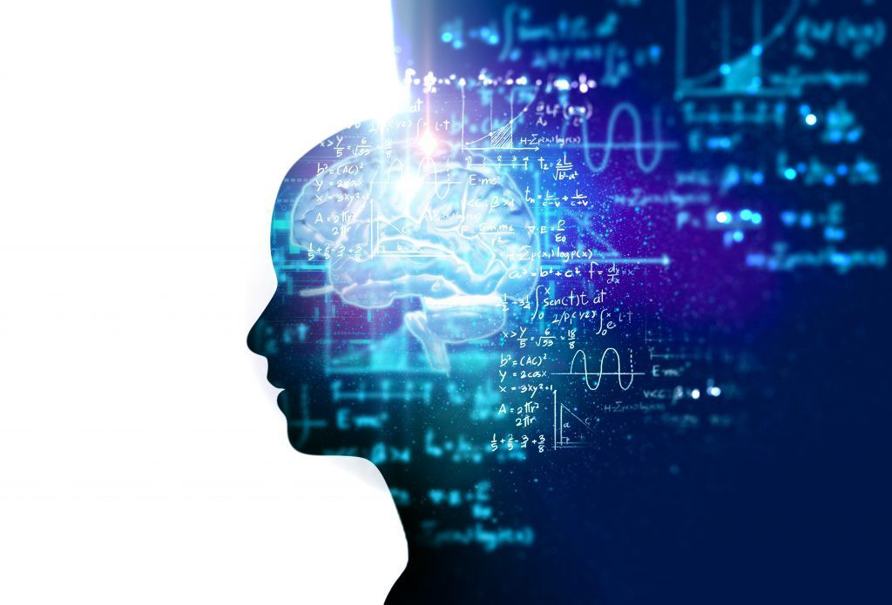
Artificial Intelligence

Slide 2
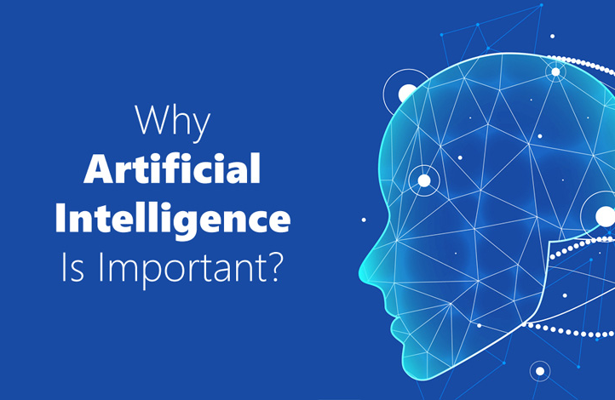

Slide 3

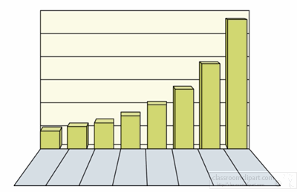

Slide 4
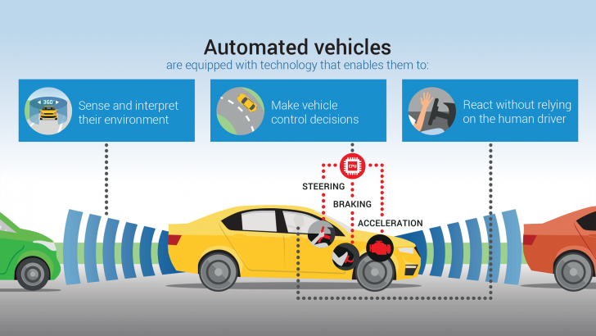

Slide 5



Slide 6


Slide 7


Slide 8
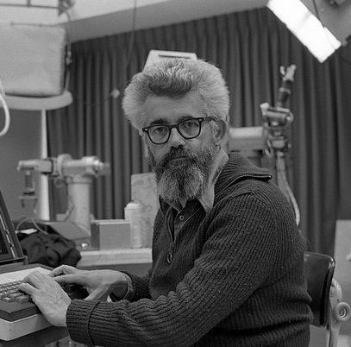
John McCarthy Father of AI

Slide 9
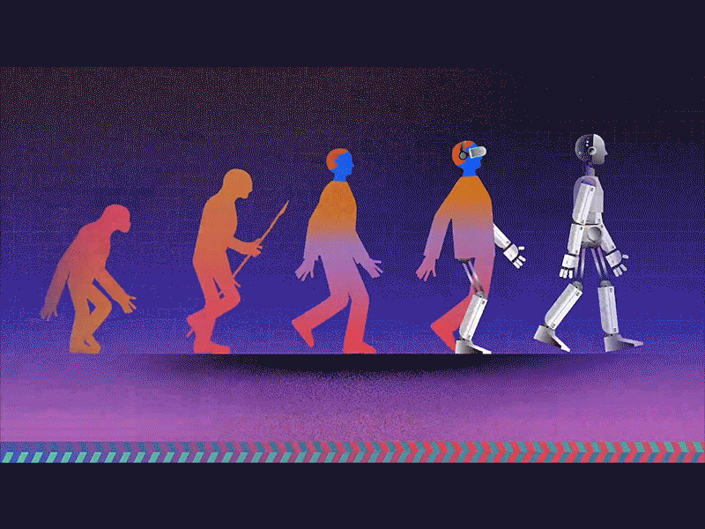
Artificial Intelligence is science and engineering making intelligent machines

Slide 10
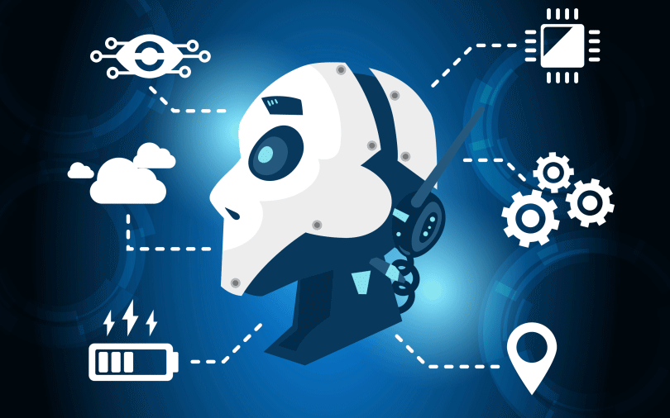
AI is technique of getting machines to work and behave like humans.

Slide 11
Healthcare
Robotics
Marketing
Business Analytics
Multimedia
Recommendation
Applications

Slide 12

Human Intelligence
Ability to learn or understand from experience
Ability to acquire and retain knowledge
Able to integrate experience and knowledge to solve problems

Slide 13
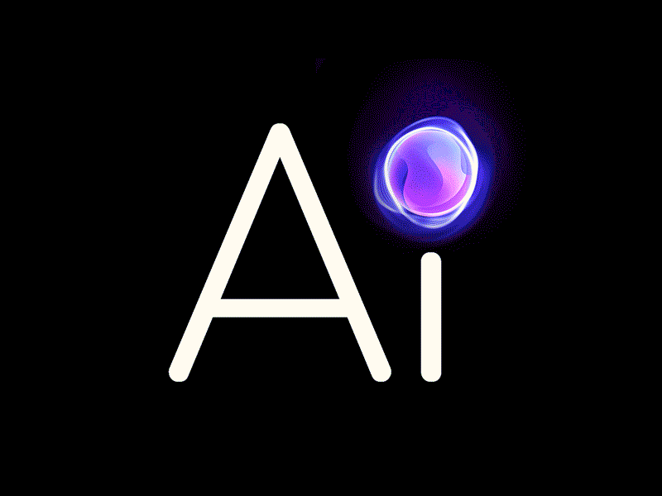

What is AI
Artificial Intelligence (AI) is a branch of computer science devoted to the study of computer hardware and software designed to imitate the thinking and reasoning powers of the human mind.
or
Man made thinking power , it is a branch of Computer science by which we can create intelligent machine which can behave, think and able to make decision like human.

Slide 14
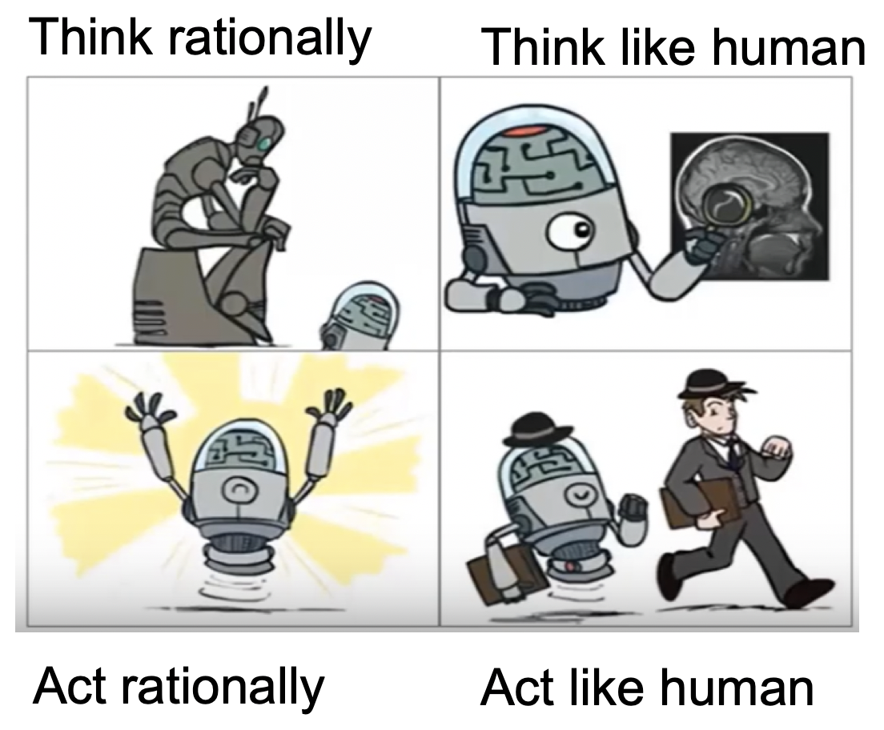
AI Definition: Making machine that can

Slide 15
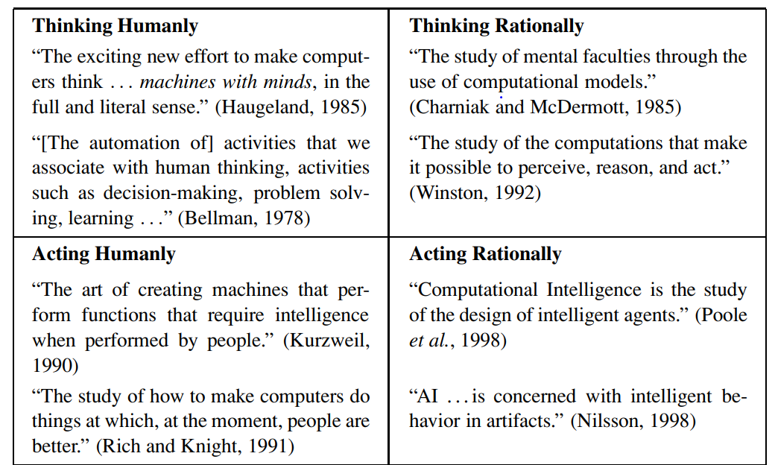

Slide 16
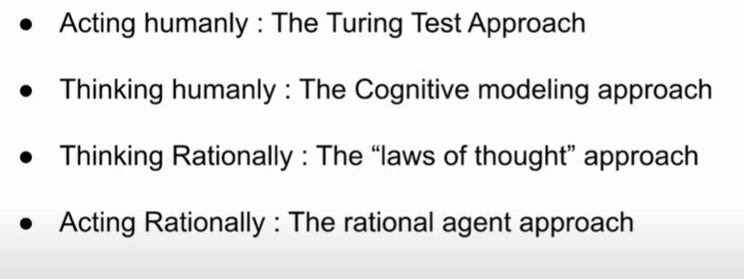

Slide 17
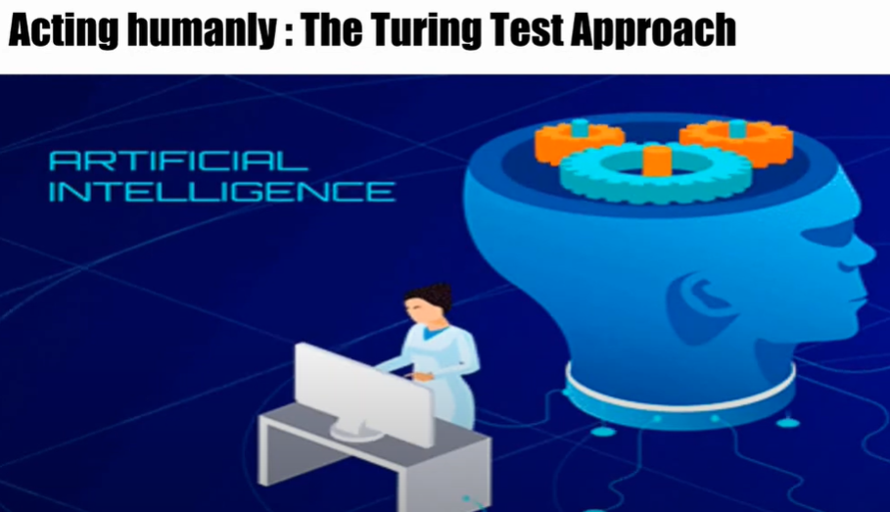
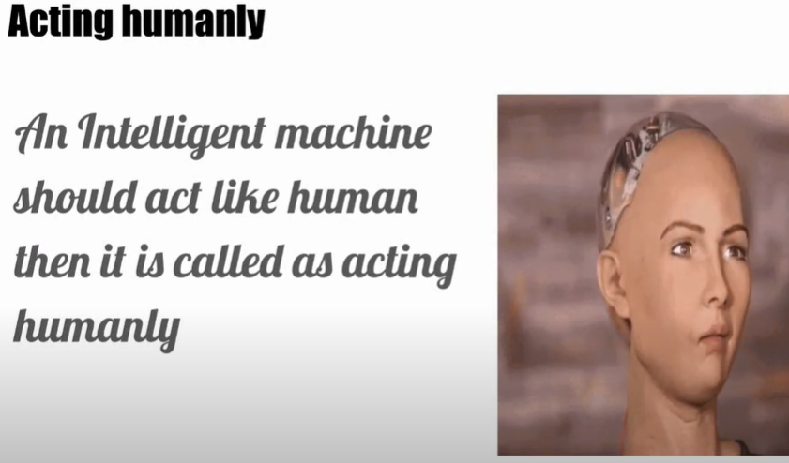

Slide 18
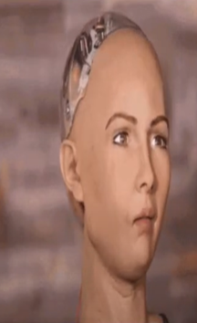
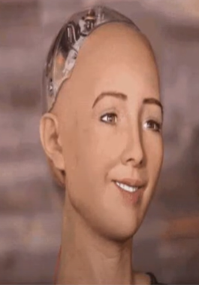


Slide 19
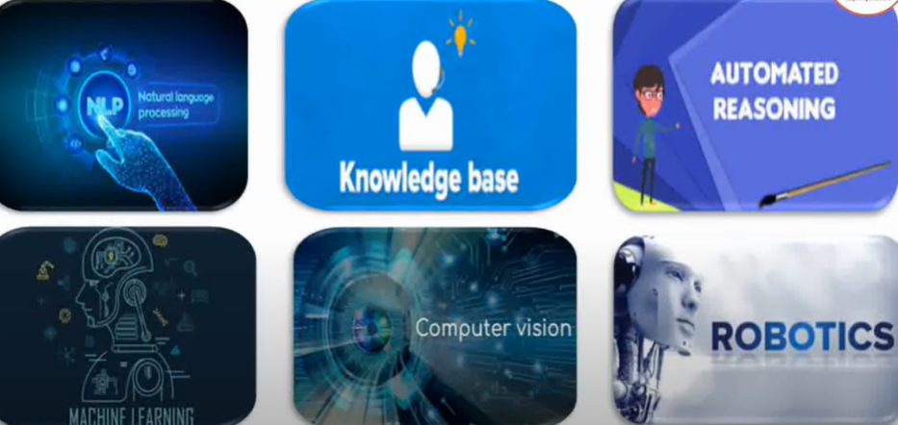
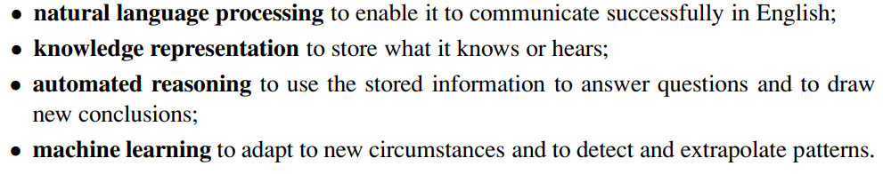
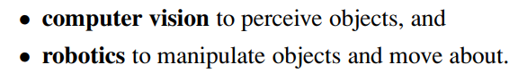
Qualities of Acting Humanly

Slide 20
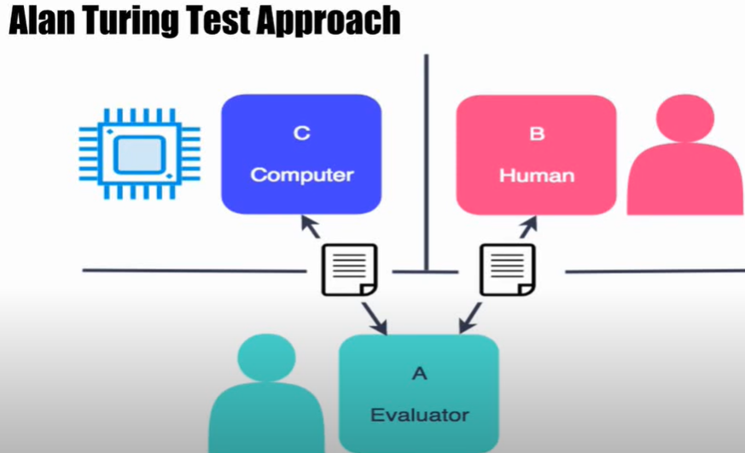

Slide 21
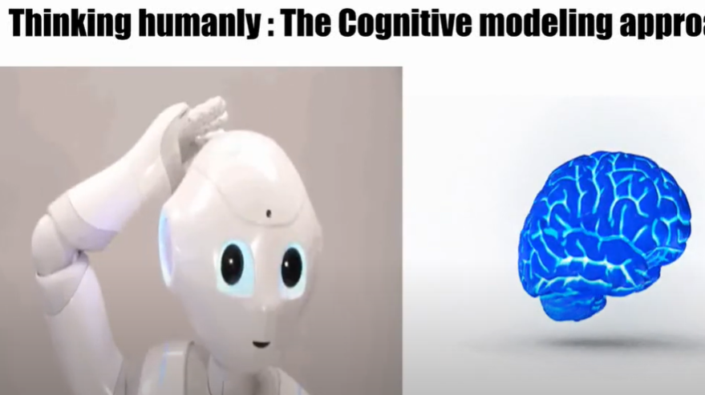
ach

Slide 22
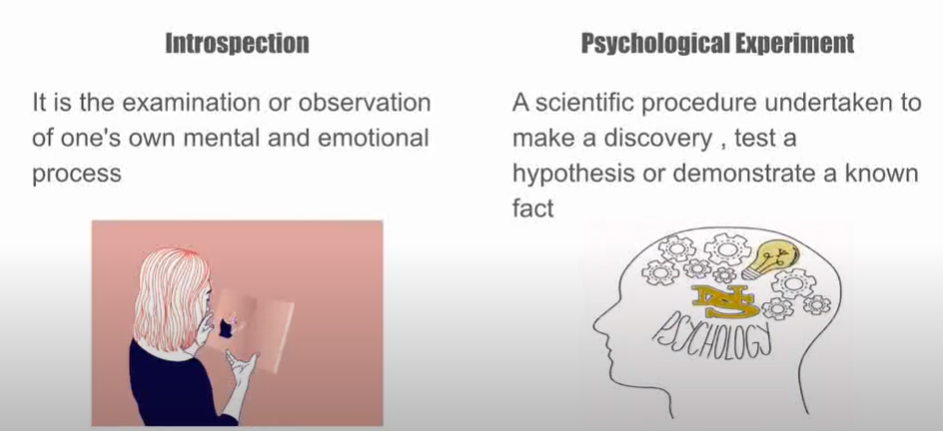
Two ways to understand how human mind works

Slide 23
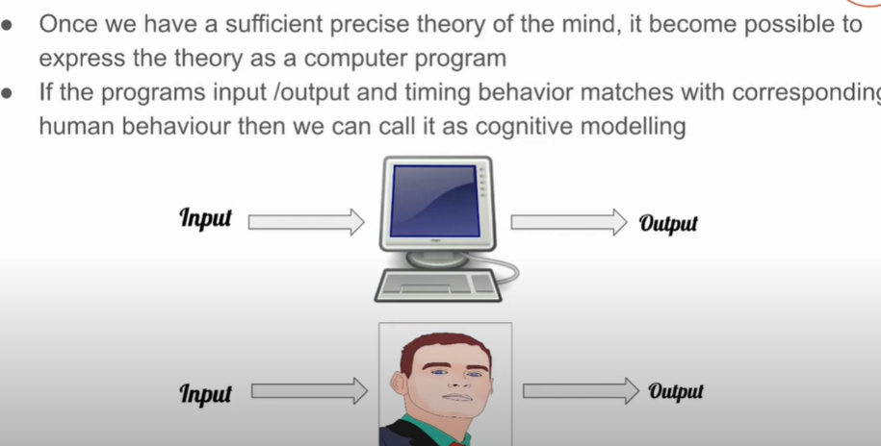

Slide 24
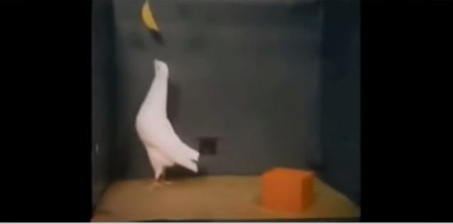
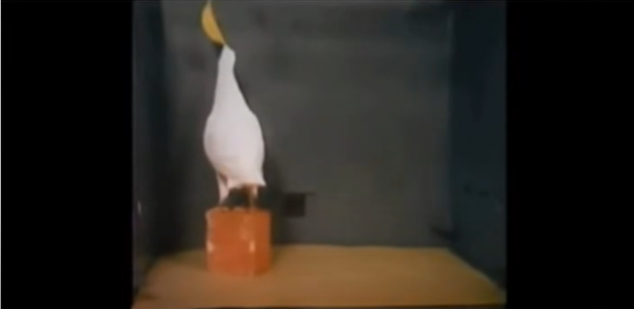

Slide 25
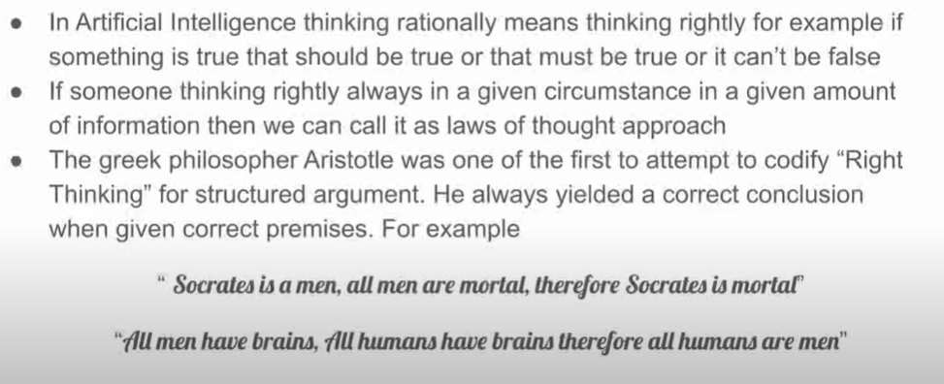
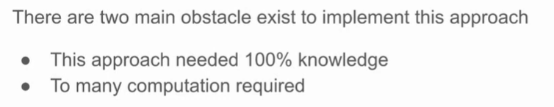

Slide 26
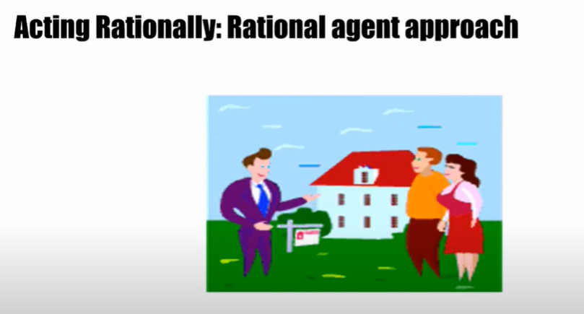

Slide 27

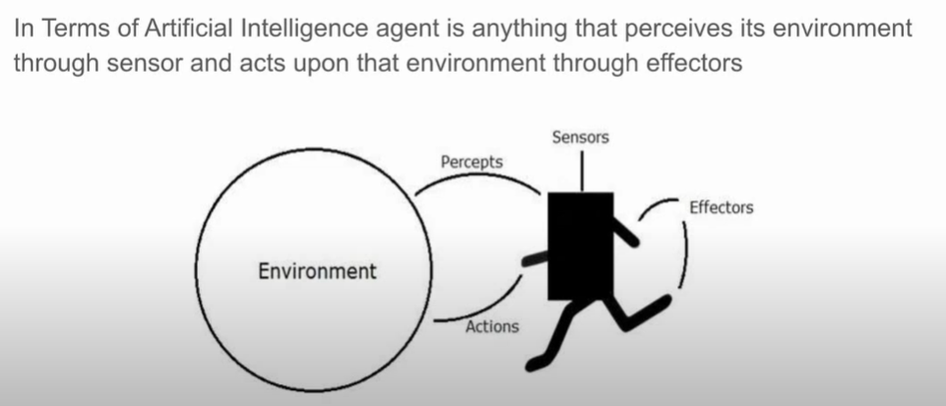

Slide 28
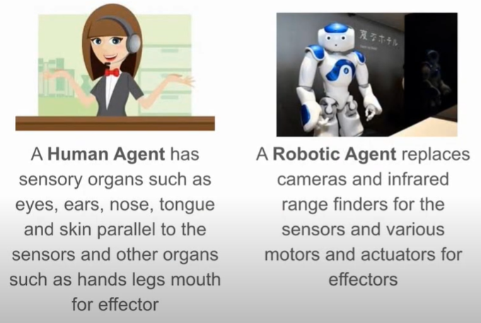
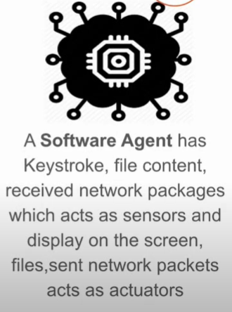

Slide 29

AI GOALS
Systems that think like humans
Systems that think rationally
Systems that act as humans
Systems that act rationally

Slide 30
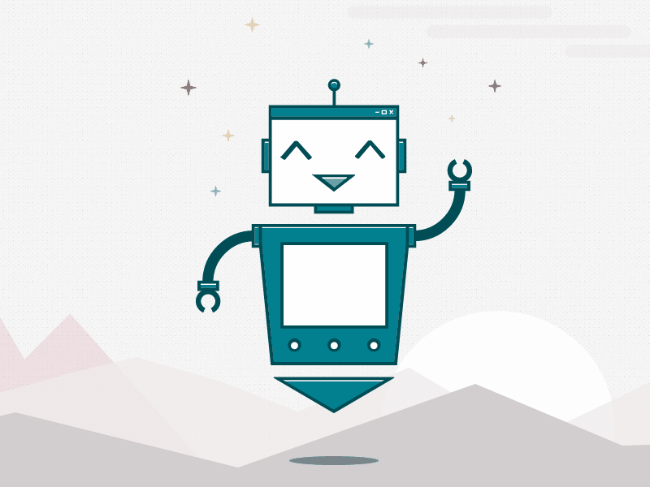


Artificial Narrow Intelligence
Artificial General Intelligence
Artificial Super Intelligence

Slide 31
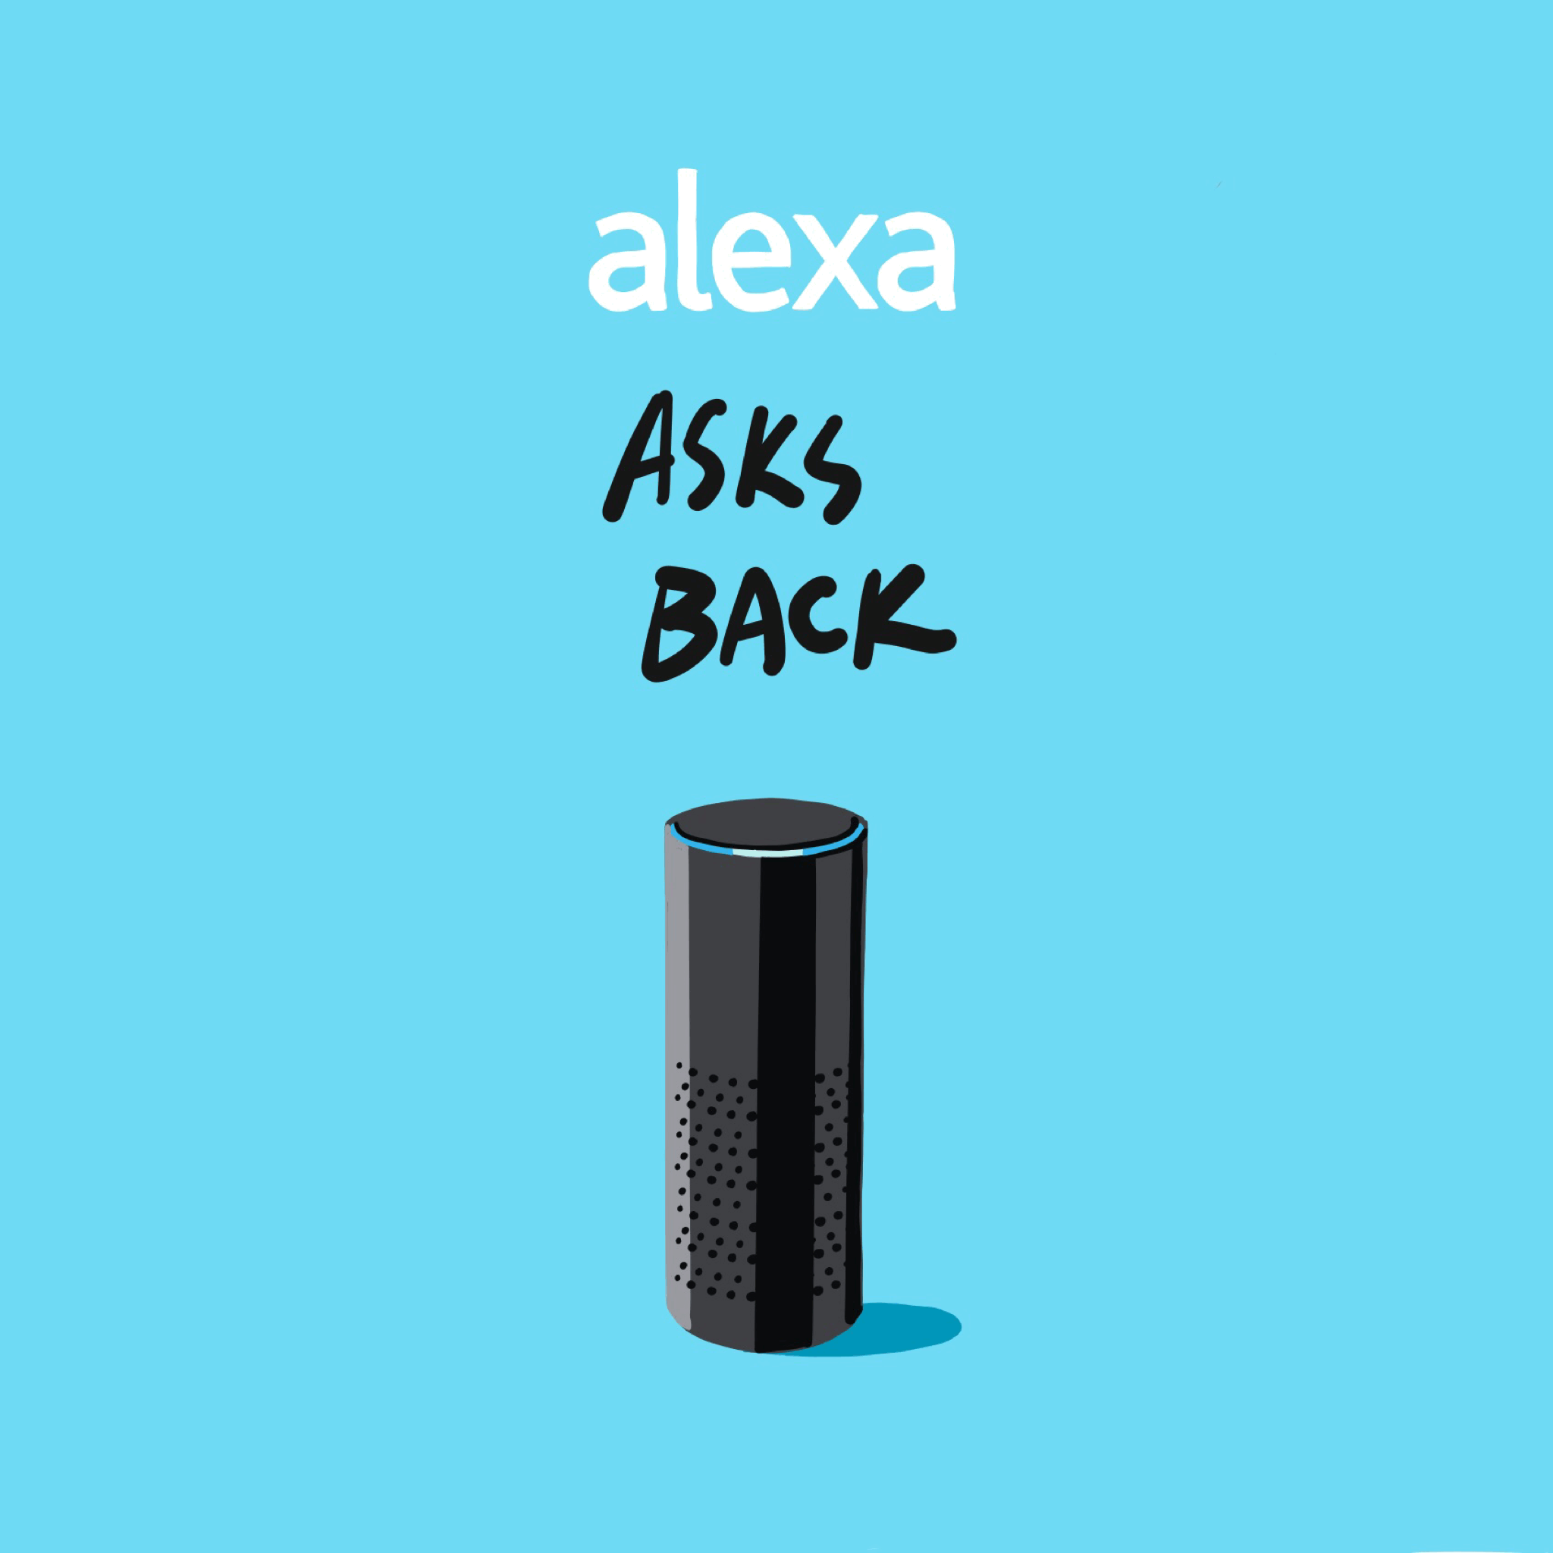
Artificial Narrow Intelligence
Artificial Narrow Intelligence which is also known as weak AI involves applying AI only specific tasks

Slide 32
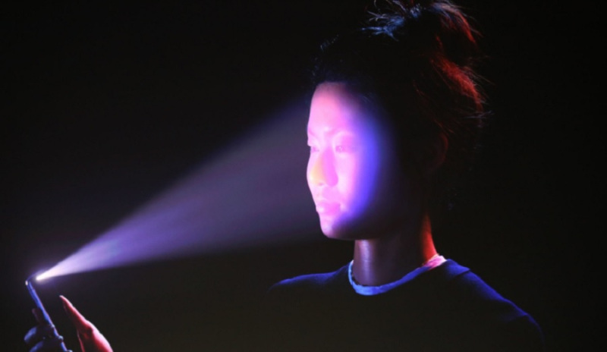
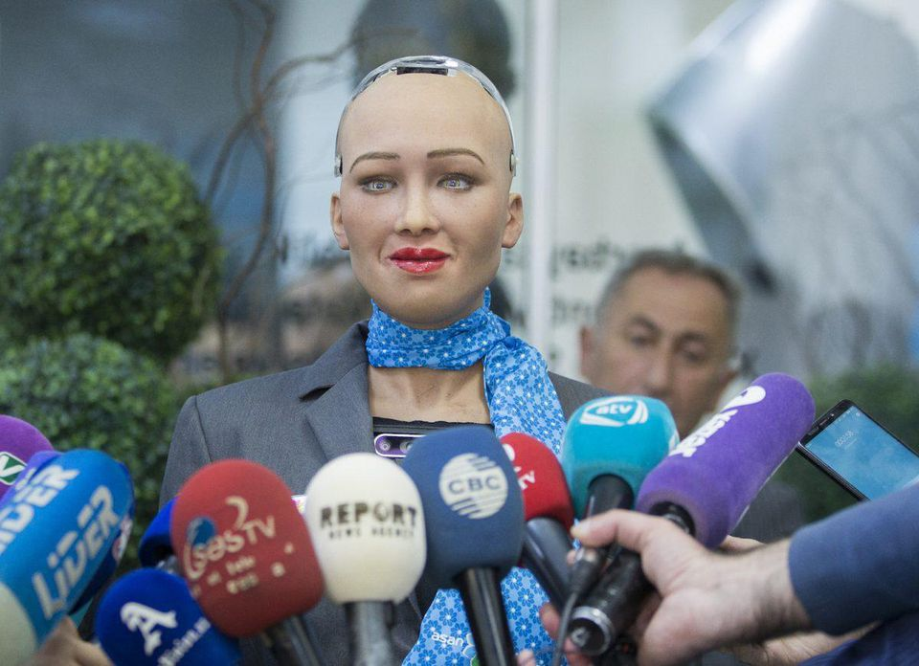
Weak AI
Face Detection
Social Humanoid Robot Sophia

Slide 33
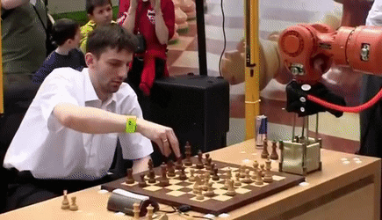
Artificial General Intelligence
Artificial General Intelligence which also known as Strong AI, involves machines that posses the ability to perform any intellectual task that a human being can.

Slide 34
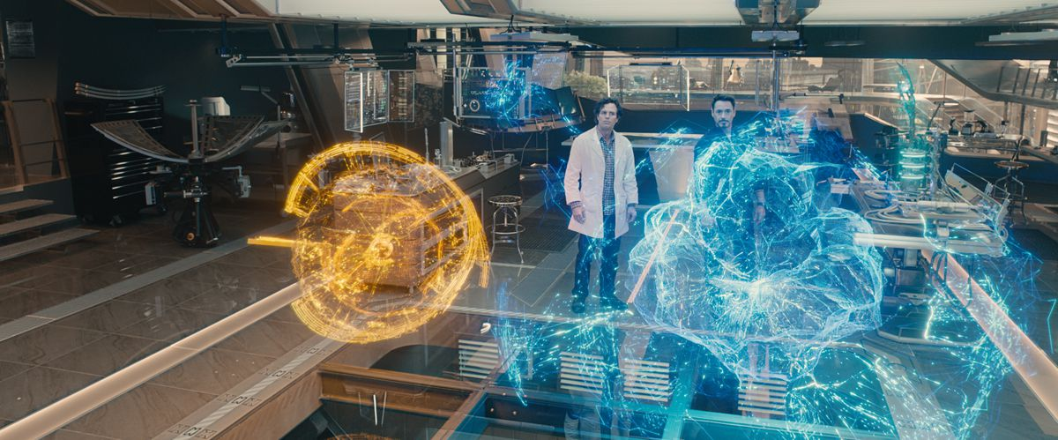
Artificial Super Intelligence is a term referring to the time when the capability of computers will surpass humans.
Artificial Super Intelligence

Slide 35
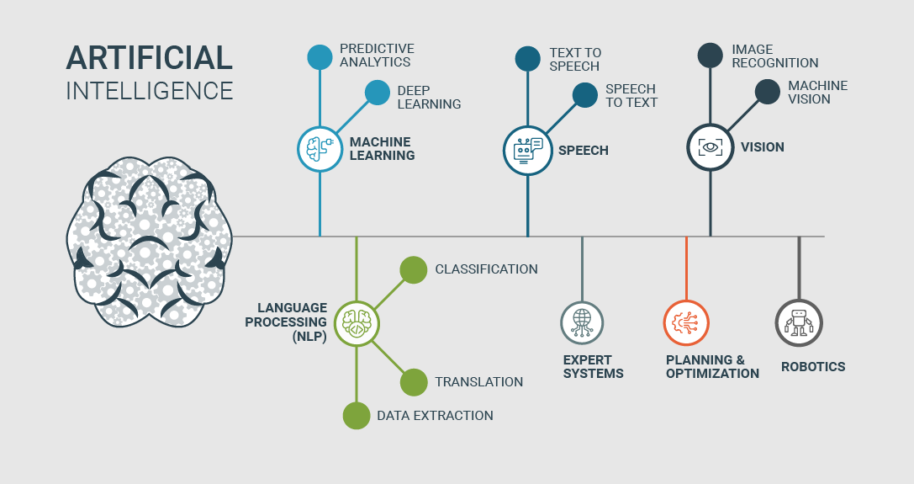

Slide 36
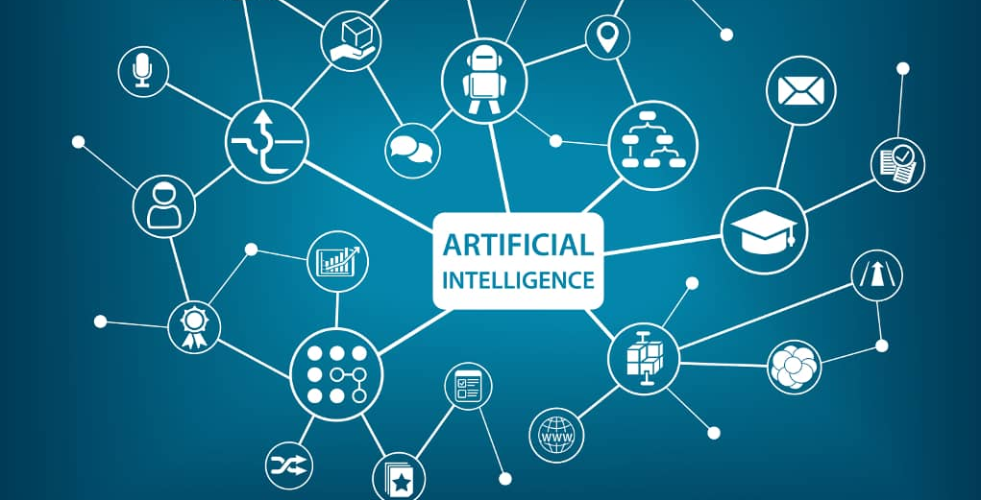

Slide 37
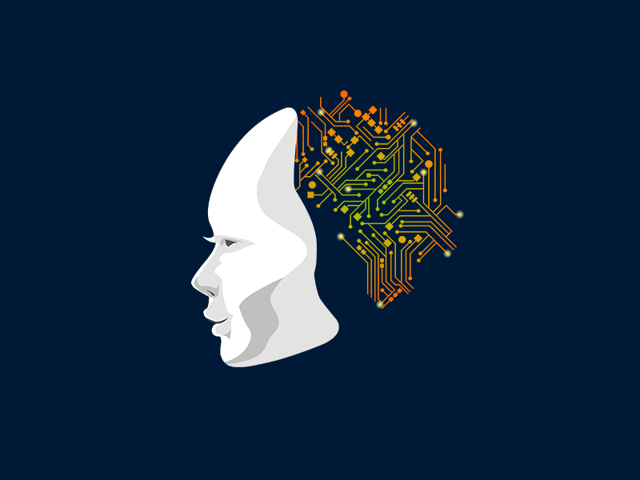

Slide 38
Why Artificial Intelligence?
With the help of AI, you can create such software or devices which can solve real-world problems very easily and with accuracy such as health issues, marketing, traffic issues, etc.
With the help of AI, you can create your personal virtual Assistant, such as Cortana, Google Assistant, Siri, etc.
With the help of AI, you can build such Robots which can work in an environment where survival of humans can be at risk.
AI opens a path for other new technologies, new devices, and new Opportunities.

Slide 39
Goals of Artificial Intelligence
Replicate human intelligence
Solve Knowledge-intensive tasks
An intelligent connection of perception and action
Building a machine which can perform tasks that requires human intelligence

Slide 40
Advantages of Artificial Intelligence
High Accuracy with less errors
High-Speed
High reliability
Useful for risky areas
Digital Assistant
Useful as a public utility

Slide 41
Disadvantages of Artificial Intelligence
High Cost
Can't think out of the box
No feelings and emotions
Increase dependency on machines
No Original Creativity

Slide 42
Application of AI
AI in Astronomy
AI in Healthcare
AI in Gaming
AI in Finance
AI in Data Security
AI in Social Media
AI in Robotics

Slide 43
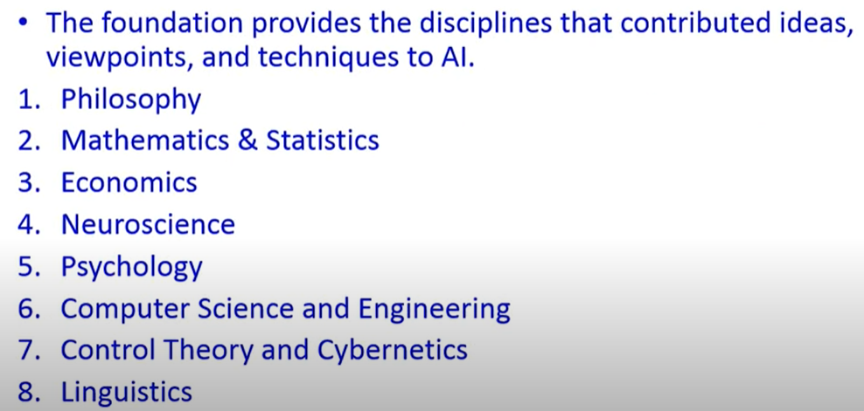
AI Prehistory

Slide 44
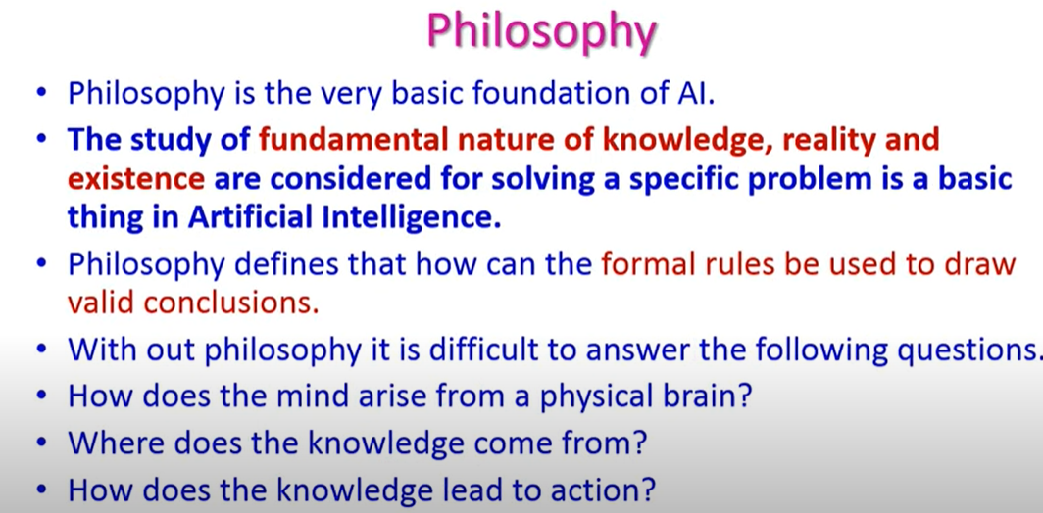

Slide 45
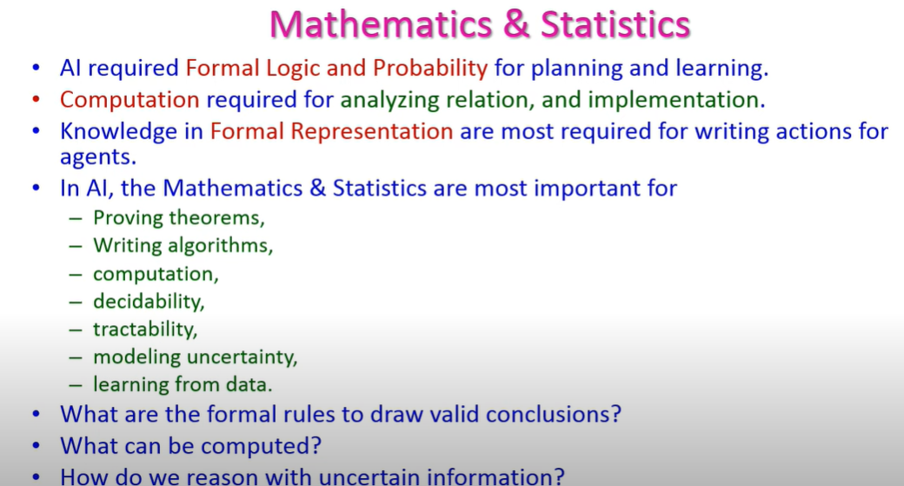

Slide 46
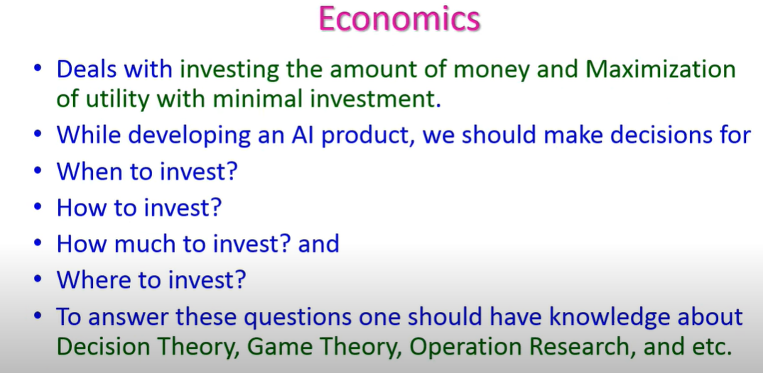

Slide 47
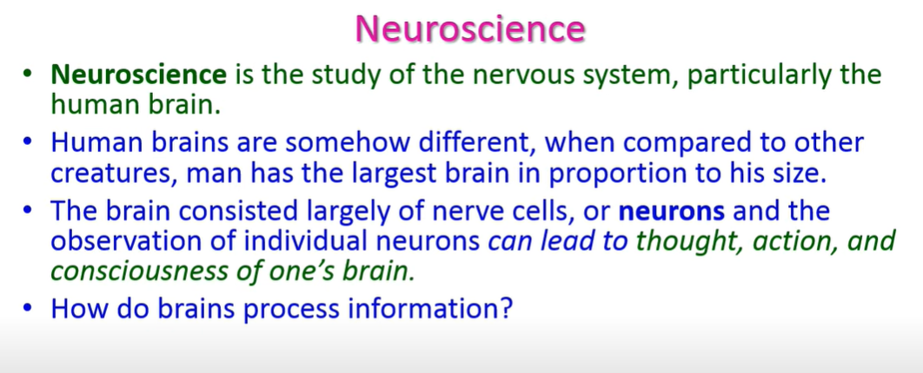
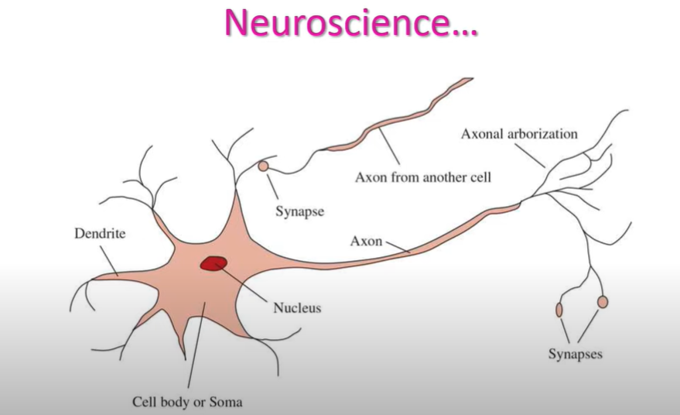

Slide 48
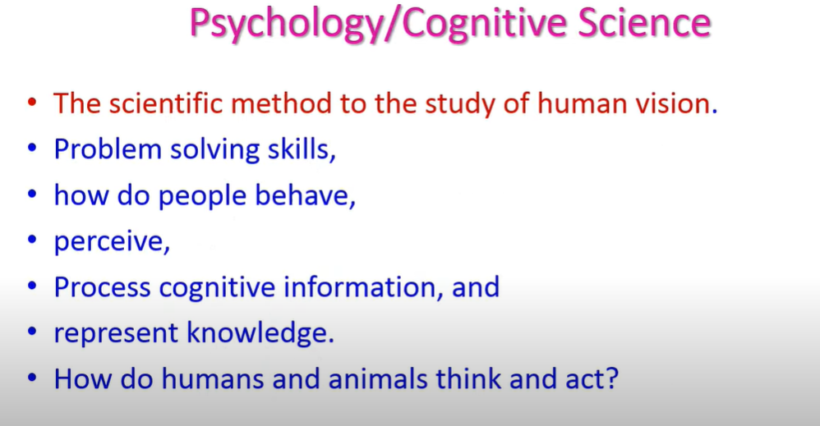

Slide 49
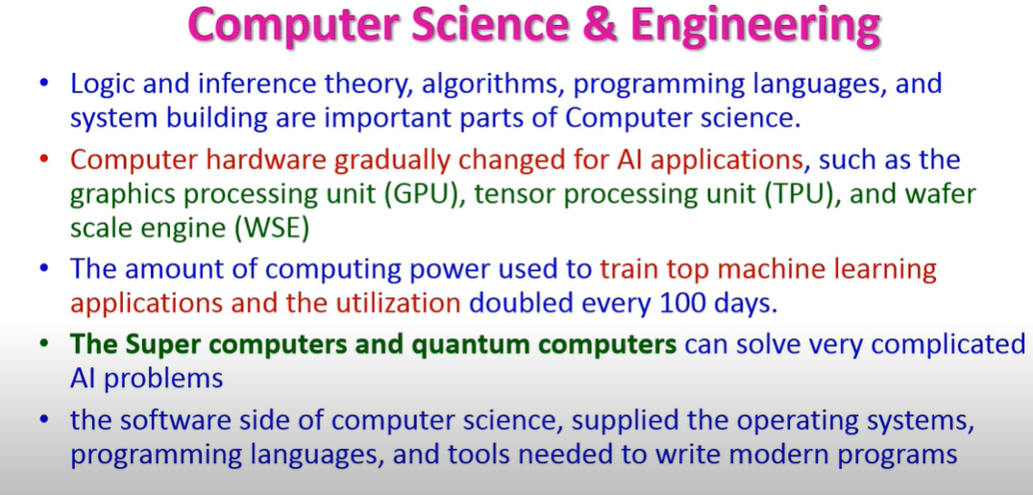

Slide 50
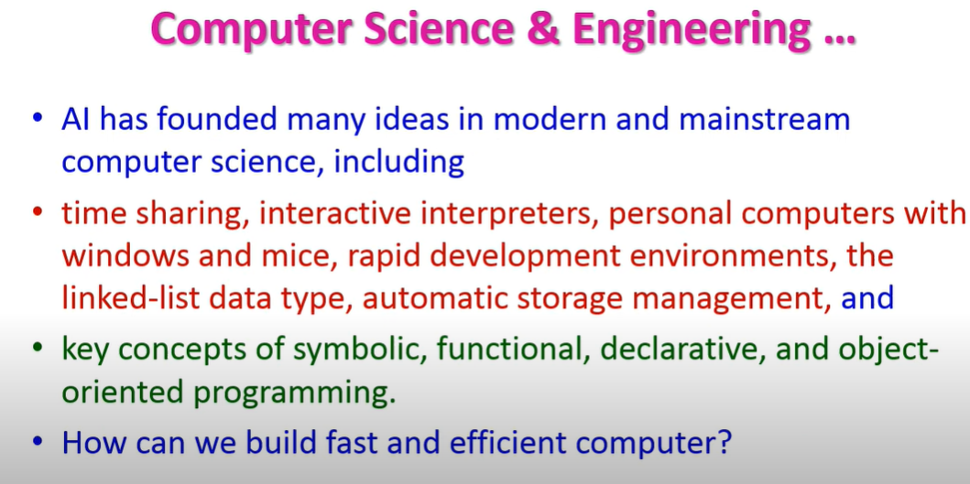

Slide 51
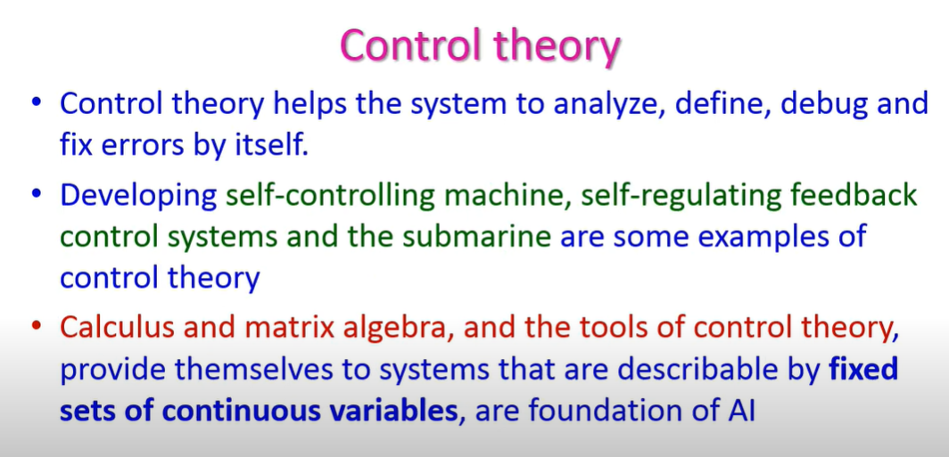

Slide 52
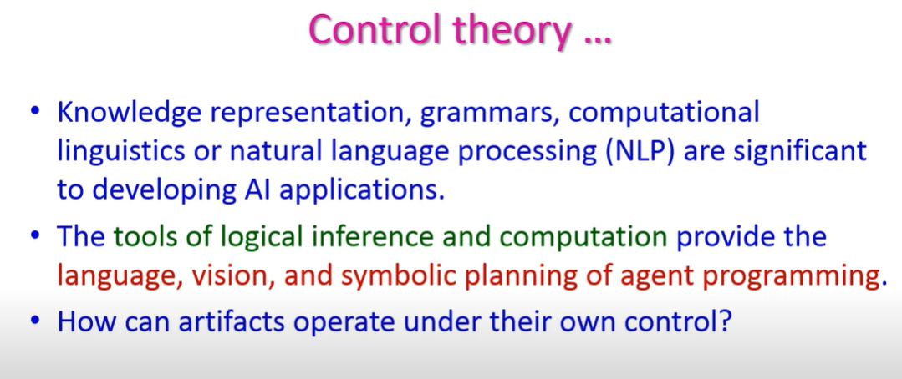

Slide 53


Slide 54


Slide 55


Slide 56


Slide 57


Slide 58


Slide 59


Slide 60


Slide 61


Slide 62


Slide 63

Types of Artificial Intelligence:

Slide 64
AI type-1: Based on Capabilities

Slide 65
1. Weak AI or Narrow AI:
Narrow AI is a type of AI which is able to perform a dedicated task with intelligence. The most common and currently available AI is Narrow AI in the world of Artificial Intelligence.
Narrow AI cannot perform beyond its field or limitations, as it is only trained for one specific task. Hence it is also termed as weak AI. Narrow AI can fail in unpredictable ways if it goes beyond its limits.
Some Examples of Narrow AI are playing chess, purchasing suggestions on e-commerce site, self-driving cars, speech recognition, and image recognition.

Slide 66
2. General AI:
General AI is a type of intelligence which could perform any intellectual task with efficiency like a human.
The idea behind the general AI to make such a system which could be smarter and think like a human by its own.
Currently, there is no such system exist which could come under general AI and can perform any task as perfect as a human.

Slide 67
3. Super AI:
Super AI is a level of Intelligence of Systems at which machines could surpass human intelligence, and can perform any task better than human with cognitive properties. It is an outcome of general AI.
Some key characteristics of strong AI include capability include the ability to think, to reason, solve the puzzle, make judgments, plan, learn, and communicate by its own.
Super AI is still a hypothetical concept of Artificial Intelligence. Development of such systems in real is still world changing task.

Slide 68
Artificial Intelligence type-2: Based on functionality

Slide 69
1. Reactive Machines
Purely reactive machines are the most basic types of Artificial Intelligence.
Such AI systems do not store memories or past experiences for future actions.
These machines only focus on current scenarios and react on it as per possible best action.
IBM's Deep Blue system is an example of reactive machines.
Google's AlphaGo is also an example of reactive machines.

Slide 70
2. Limited Memory
Limited memory machines can store past experiences or some data for a short period of time.
These machines can use stored data for a limited time period only.
Self-driving cars are one of the best examples of Limited Memory systems. These cars can store recent speed of nearby cars, the distance of other cars, speed limit, and other information to navigate the road.

Slide 71
3. Theory of Mind
Theory of Mind AI should understand the human emotions, people, beliefs, and be able to interact socially like humans.
This type of AI machines are still not developed, but researchers are making lots of efforts and improvement for developing such AI machines.

Slide 72
4. Self-Awareness
Self-awareness AI is the future of Artificial Intelligence. These machines will be super intelligent, and will have their own consciousness, sentiments, and self-awareness.
These machines will be smarter than human mind.
Self-Awareness AI does not exist in reality still and it is a hypothetical concept.

Slide 73
State of the Art
What can AI do today? A concise answer is difficult because there are so many activities in so many subfields. Here we sample a few applications
Robotic vehicles: A driverless robotic car named STANLEY sped through the rough terrain of the Mojave dessert
Speech recognition: A traveler calling United Airlines to book a flight can have the entire conversation guided by an automated speech recognition and dialog management system
Autonomous planning and scheduling: A hundred million miles from Earth, NASA’s Remote Agent program became the first on-board autonomous planning program to control the scheduling of operations for a spacecraft
Game playing: IBM’s DEEP BLUE became the first computer program to defeat the world champion in a chess match when it bested Garry Kasparov by a score of 3.5 to 2.5 in an exhibition match

Slide 74
State of the Art
Spam fighting: Each day, learning algorithms classify over a billion messages as spam, saving the recipient from having to waste time deleting what, for many users, could comprise 80% or 90% of all messages, if not classified away by algorithms
Logistics planning: During the Persian Gulf crisis of 1991, U.S. forces deployed a Dynamic Analysis and Replanning Tool, DART (Cross and Walker, 1994), to do automated logistics planning and scheduling for transportation.
Robotics: The iRobot Corporation has sold over two million Roomba robotic vacuum cleaners for home use.
Machine Translation: A computer program automatically translates from Arabic to English

Slide 75
State of the Art
Have the following been achieved by AI?
World-class chess playing
Playing table tennis
Cross-country driving
Solving mathematical problems
Discover and prove mathematical theories
Engage in a meaningful conversation
Understand spoken language
Observe and understand human emotions
Express emotions
…

Slide 76
THANK YOU

